Slide 1

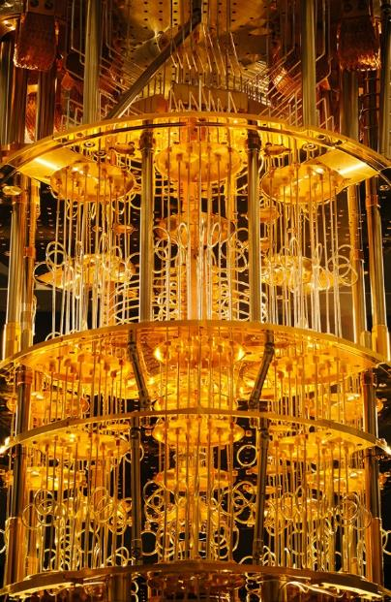
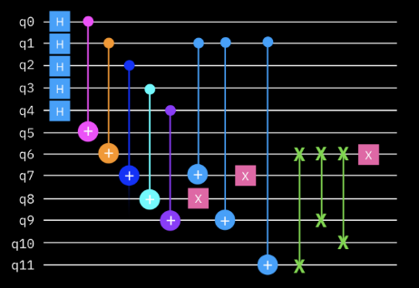



Foundations of
Quantum Information Science (QIS 102)
Dave Biersach
Brookhaven National Laboratory
dbiersach@bnl.gov
Session 21
Quantum Circuits

Slide 2
Session 21 – Goals
Review Unitary Matrices and how they enable reversible computing
Understand the main Quantum Gates (X, Y, Z, H) and their affect on a qubit’s state vector and location on the Bloch Sphere
Apply the controlled gates (CNOT, CCNOT, and CSWAP) and the significance if their control line is in superposition
Correlate State Vector Notation to Ket Notation
Determine if equivalent states have equal amplitudes or equal probabilities by considering the action of the Square Root of NOT operator

Slide 3
Session 21 – Goals
Consider how to represent multiple qubits and why we cannot simulate large quantum registers on classical computers
Demonstrate a series of quantum gate identities
Understand the limitations implied by the No Cloning Theorem
Use the IBM Qiskit SDK to create qubits, invoke quantum gates, build quantum circuits, and how to measure the values of the qubits
Appreciate techniques to encode information into the phase of qubits

Slide 4
Session 21 – Goals
Place qubits into superposition using the Hadamard gate
Review the IBM Qiskit Bitstring Notation
Using controlled quantum gates to entangle two or more qubits
Appreciate Bell’s Theorem and maximally entangled qubits
Simulate classical Boolean gates using Quantum gates
Discuss the physical implementation of qubits and how a quantum computer executes your circuits

Slide 5
Representing a Qubit
We can represent a qubit as a state vector – a linear sum of complex numbers (amplitudes) that are the components of an operator expressed using the canonical basis for $ℂ^{2}$
$$\left[\begin{matrix}c_{0} \\ c_{1}\end{matrix}\right]=c_{0}∙\left[\begin{matrix}1 \\ 0\end{matrix}\right]+c_{1}∙\left[\begin{matrix}0 \\ 1\end{matrix}\right]=c_{0}\left.\left|0\right.\right\rangle +c_{1}\left.\left|1\right.\right\rangle$$
Example:
$$\left[\begin{matrix}3+2i \\ 4−2i\end{matrix}\right]=(3+2i)\left.\left|0\right.\right\rangle +(4−2i)\left.\left|1\right.\right\rangle$$
$$c_{0}$$
$$c_{1}$$

Slide 6
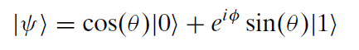
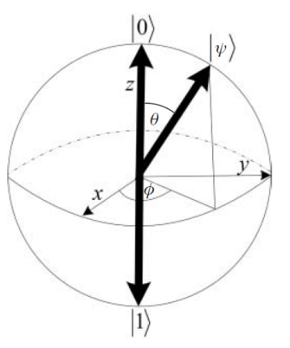
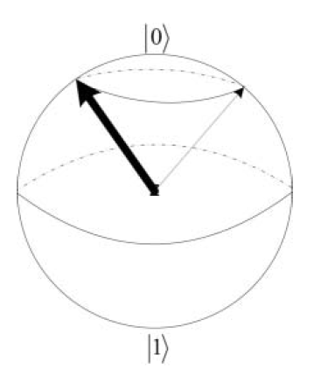
The Bloch Sphere
$$φ=φ_{1}−φ_{0}$$
Only $θ$ affects the probability $Ψ$ will collapse to either $\left|\left.0\right\rangle \right.$ or $\left|\left.1\right\rangle \right.$
$φ$ represents the qubit phase which we cannot measure
A qubit pointing anywhere around the equator has a 50/50 chance of collapsing to either $\left.\left|0\right.\right\rangle$ or $\left.\left|1\right.\right\rangle$
Changing the phase $φ$ does not affect the probability of the state to which it will collapse: $\left.\left|0\right.\right\rangle$ or $\left.\left|1\right.\right\rangle$
Every unitary 2x2 operator (a quantum gate) will "rotate" this sphere in some way

Slide 7
The Bloch Sphere
The
z basis
$\left|\left.ψ\right\rangle \right.$ $=\cos\left(θ\right)\left|\left.0\right\rangle \right.+e^{iφ}\sin\left(θ\right)\left|\left.1\right\rangle \right.$
$$0≤θ≤2π$$
$$\left|\left.ψ\right\rangle \right.=\left[\begin{matrix}α \\ β\end{matrix}\right]=α\left|\left.0\right\rangle \right.+β\left|\left.1\right\rangle \right.$$
$$0≤φ≤2π$$
Note: Probabilities require measurements, and we can't measure global phase $∴$ $φ=0$
$$α=\cos\left(\frac{θ}{2}\right)$$
$$β=\sin\left(\frac{θ}{2}\right)$$
$$θ=0$$
$$P\left(0\right)={\left(\cos{\frac{0}{2}}\right)}^{2}\left|\left.0\right\rangle \right.+{\left(\sin{\frac{0}{2}}\right)}^{2}\left|\left.1\right\rangle \right.={\left[\begin{matrix}1 & 0\end{matrix}\right]}^{T}$$
$\left|\text{0}⟩\right.$ in the z basis
$$θ=π$$
$$P\left(π\right)={\left(\cos{\frac{π}{2}}\right)}^{2}\left|\left.0\right\rangle \right.+{\left(\sin{\frac{π}{2}}\right)}^{2}\left|\left.1\right\rangle \right.={\left[\begin{matrix}0 & 1\end{matrix}\right]}^{T}$$
$\left|\text{1}⟩\right.$ in the z basis
$$θ=π/2$$
$$P\left(\frac{π}{2}\right)={\left(\cos{\frac{π}{4}}\right)}^{2}\left|\left.0\right\rangle \right.+{\left(\sin{\frac{π}{4}}\right)}^{2}\left|\left.1\right\rangle \right.={\left[\begin{matrix}\frac{1}{2} & \frac{1}{2}\end{matrix}\right]}^{T}$$
50/50 superposition

Slide 8
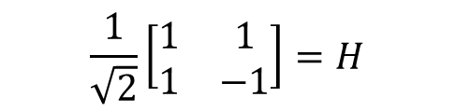
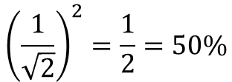
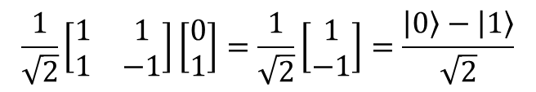
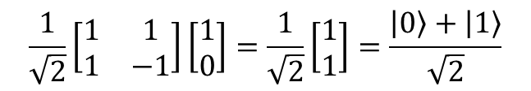
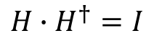
Unitary Matrices
$$\frac{1}{\sqrt{2}}\left[\begin{matrix}1 & 1 \\ 1 & −1\end{matrix}\right]=H$$
$$H∙H^{†}=I$$
Hadamard Gate
Hadamard Matrix is Unitary
0
$$\frac{1}{\sqrt{2}}\left[\begin{matrix}1 & 1 \\ 1 & −1\end{matrix}\right]\left[\begin{matrix}1 \\ 0\end{matrix}\right]=\frac{1}{\sqrt{2}}\left[\begin{matrix}1 \\ 1\end{matrix}\right]=\frac{\left.\left|0\right.\right\rangle +\left.\left|1\right.\right\rangle }{\sqrt{2}}$$
A Hadamard gate puts a qubit into a superposition of states, with a 50/50 chance of getting a 0 or 1
1
$$\frac{1}{\sqrt{2}}\left[\begin{matrix}1 & 1 \\ 1 & −1\end{matrix}\right]\left[\begin{matrix}0 \\ 1\end{matrix}\right]=\frac{1}{\sqrt{2}}\left[\begin{matrix}1 \\ −1\end{matrix}\right]=\frac{\left.\left|0\right.\right\rangle −\left.\left|1\right.\right\rangle }{\sqrt{2}}$$
$${\left(\frac{1}{\sqrt{2}}\right)}^{2}=\frac{1}{2}=50\%$$
Note: these are not the same states, yet they have the same expectation values (probabilities) of 50% zero, 50% one

Slide 9
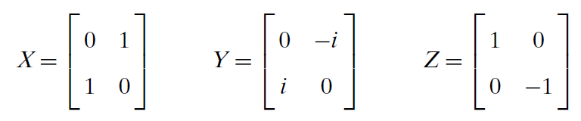
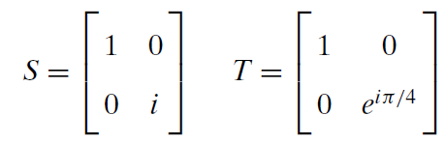
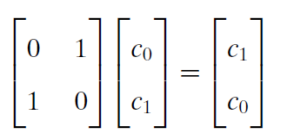
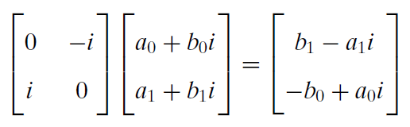
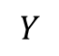
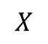
Unitary Matrices
Here are some additional fundamental unitary matrices that can act on qubits:
Phase
"Shift"
Phase
"Twist"
$$X$$
$$Y$$

Slide 10
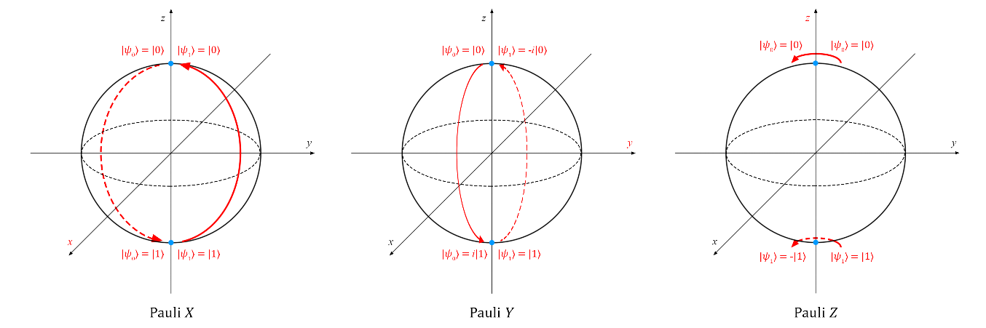
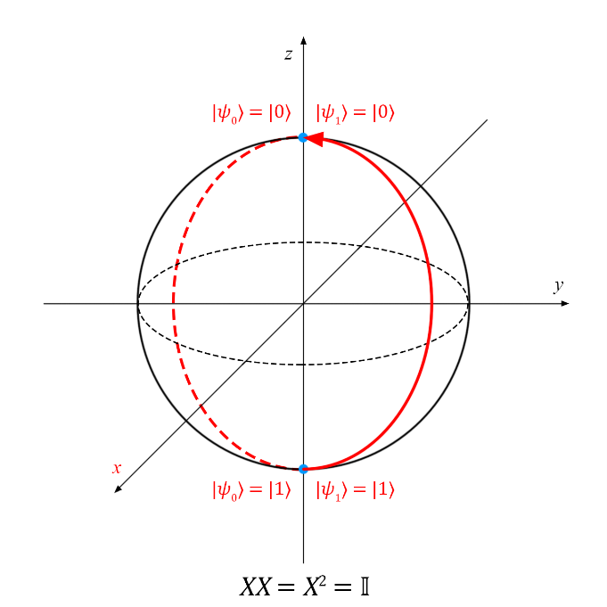
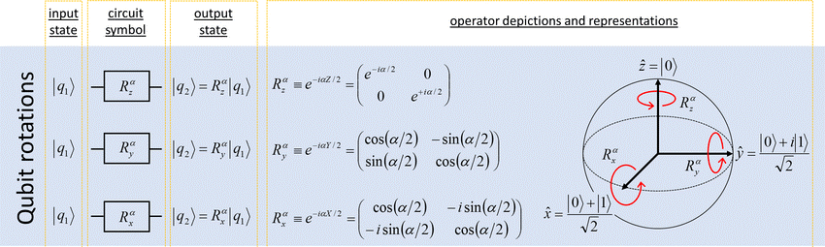
Unitary Matrices

Slide 11
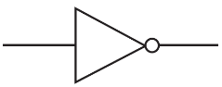
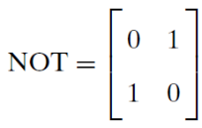
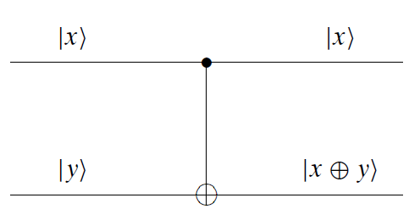
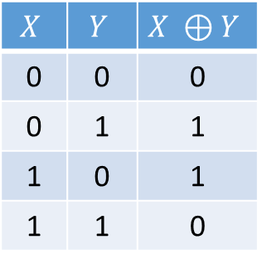
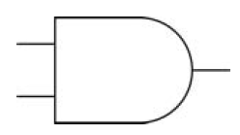
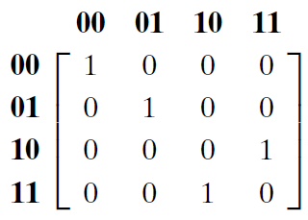
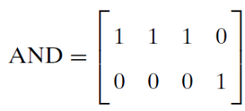
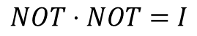
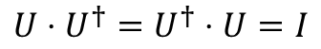
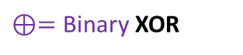
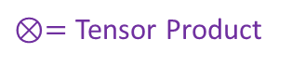
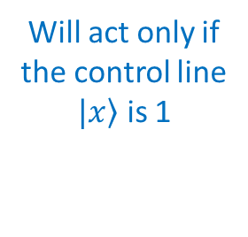
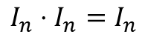
Quantum Gates
Reversible?
In the quantum world, all operations that are not measurements must be reversible and must be represented by unitary matrices
$$U⋅U^{†}=U^{†}⋅U=I$$
$$I_{n}⋅I_{n}=I_{n}$$
Controlled NOT (CNOT)
$⊗=$ Tensor Product
Control Line
$$NOT⋅NOT=I$$
1
1
$⊕=$ Binary XOR
Yes
1
Target
0
x y
in
out
x y
Will act only if the control line
$\left.|x\right\rangle$ is 1
CNOT is reversible and universal for Quantum computing
No

Slide 12
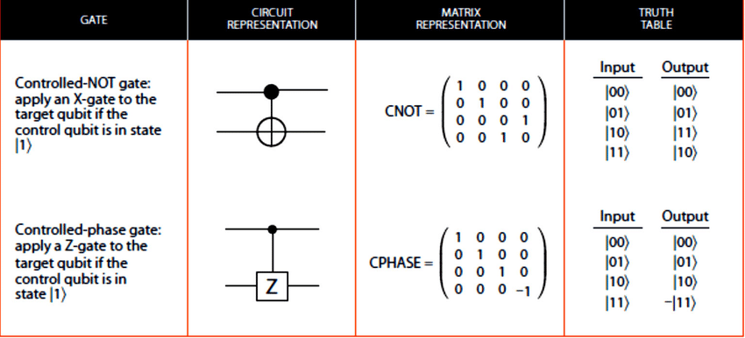
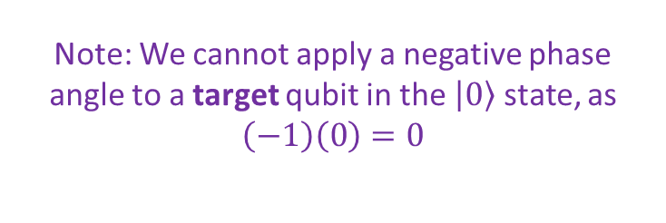
Quantum Gates
Note: We cannot apply a negative phase angle to a target qubit in the $\left|\left.0\right\rangle \right.$ state, as $\left(−1\right)\left(0\right)=0$

Slide 13
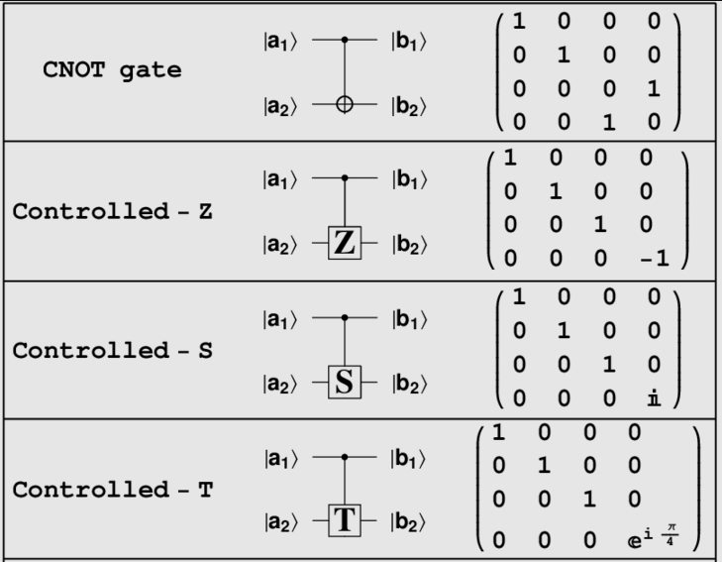
Quantum Gates

Slide 14
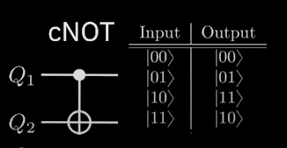
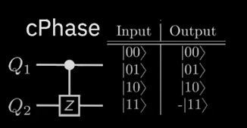
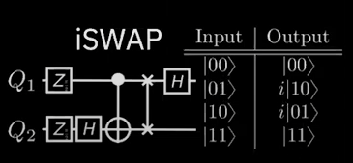
Quantum Gates

Slide 15
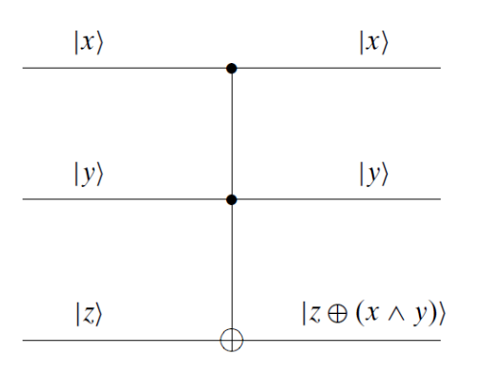
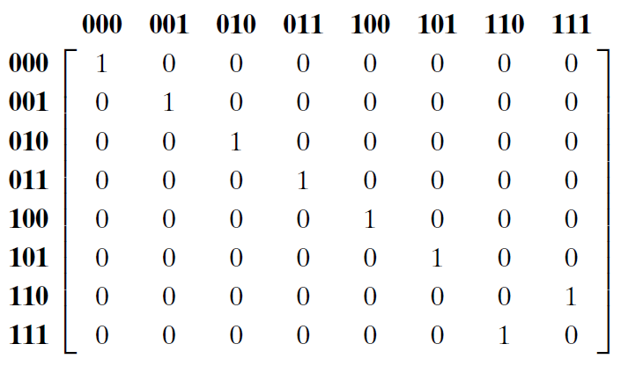
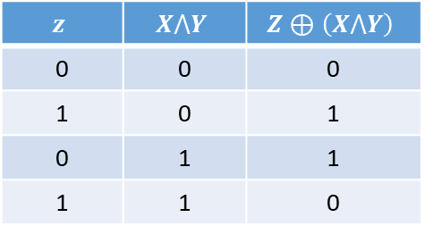
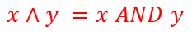
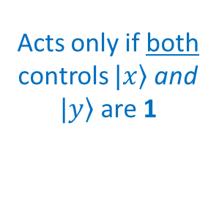
Quantum Gates
The CCNOT is reversible and universal for both Boolean & Quantum computing
Controlled Controlled NOT (CCNOT)
x y z
in
Control Line 1
1
1
out
Control Line 2
1
1
$$x∧y =x AND y$$
0
1
Acts only if both controls $\left.|x\right\rangle$and $\left.|y\right\rangle$are 1
CCNOT is reversible
$$z$$ | $$X⋀Y$$ | $$Z⊕\left(X⋀Y\right)$$
0 | 0 | 0
1 | 0 | 1
0 | 1 | 1
1 | 1 | 0
A Toffoli Gate

Slide 16
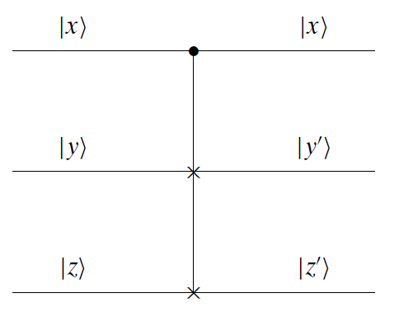
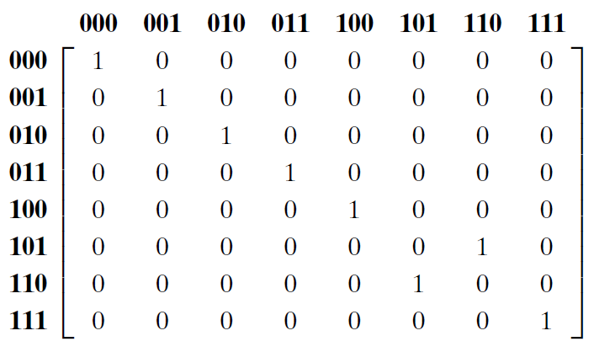
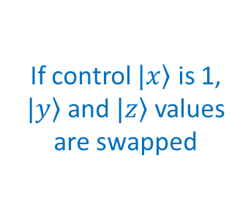
Quantum Gates
Controlled Swap (CSWAP)
x y z
in
Control Line
1
1
out
1
0
0
1
If control $\left.|x\right\rangle$ is 1,
$\left.|y\right\rangle$ and $\left.|z\right\rangle$ values are swapped
CSWAP is reversible
The CSWAP is reversible and universal for Quantum computing
A Fredkin Gate

Slide 17
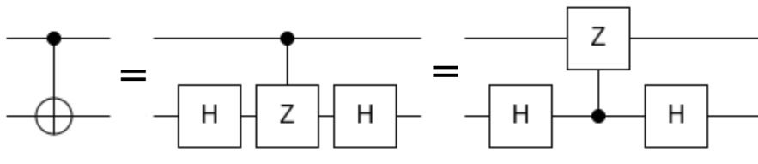
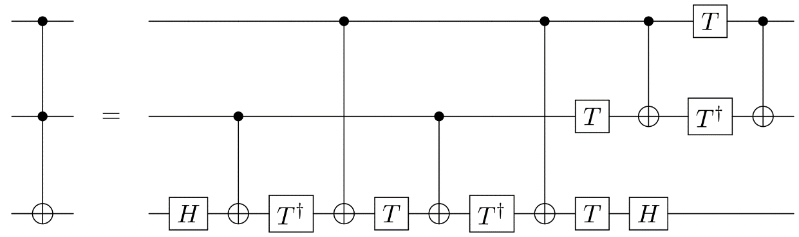
Quantum Gates
Gates like CNOT and CCNOT are made by combining unitary matrices like X, Y, Z, S, T, and H
CNOT
CCNOT

Slide 18
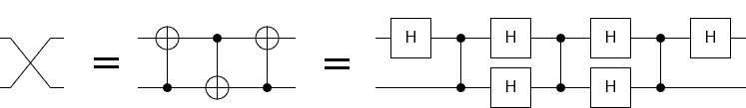
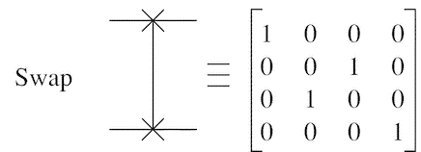

Quantum Gates
We can create a SWAP gate using three CNOT gates or six Hadamard Gates + three CZ Gates
The unitary matrix for a SWAP gate

Slide 19

Quantum Gates

Slide 20






Amplitude vs. Probability
State Vector Notation
Addition is Commutative, Subtraction is NOT
Ket Notation
Note: these two are not the same states, yet they have the same expectation values (probabilities)

Slide 21









Amplitude vs. Probability
$\sqrt{NOT}$ is Unitary
$$\left(\sqrt{NOT}\right)⋅{\left(\sqrt{NOT}\right)}^{†}=I$$
$$A⋅A=A^{2}$$
$$A⋅A^{†}=I$$
$$\sqrt{NOT}$$
$$\sqrt{NOT}$$
But are these two "zeros" the same state?
Scalar multiplication of $\left.\left|ψ\right.\right\rangle$ does not change the probabilities
$$\left.\left(s\right)\left|ψ\right.\right\rangle ⟼p\left(x_{i}\right)$$

Slide 22

Representing Multiple Qubits
$${\left[\begin{matrix}0 \\ 1\end{matrix}\right]}^{⨂3}=\left[\begin{matrix}0 \\ 1\end{matrix}\right]⨂\left[\begin{matrix}0 \\ 1\end{matrix}\right]⨂\left[\begin{matrix}0 \\ 1\end{matrix}\right]$$
$$=\left[\begin{matrix}0 \\ 1\end{matrix}\right]⨂\left[\begin{matrix}\left(0\right)\left[\begin{matrix}0 \\ 1\end{matrix}\right] \\ \left(1\right)\left[\begin{matrix}0 \\ 1\end{matrix}\right]\end{matrix}\right]=\left[\begin{matrix}0 \\ 1\end{matrix}\right]⨂\left[\begin{matrix}0 \\ 0 \\ 0 \\ 1\end{matrix}\right]$$
0
$$=\left[\begin{matrix}\left(0\right)\left[\begin{matrix}0 \\ 0 \\ 0 \\ 1\end{matrix}\right] \\ \left(1\right)\left[\begin{matrix}0 \\ 0 \\ 0 \\ 1\end{matrix}\right]\end{matrix}\right]=\left[\begin{matrix}0 \\ 0 \\ 0 \\ 0 \\ 0 \\ 0 \\ 0 \\ 1\end{matrix}\right]=\left|\left.111\right\rangle \right.$$
$${111}_{2}=7_{10}$$
7

Slide 23









Representing Multiple Qubits
0
1
1
0
1
0
1
1
A qubyte
$${\left(ℂ^{2}\right)}^{⊗8}=ℂ^{256}$$
A Quantum Register
0
A classical computer would have to store 256 potentially complex numbers to fully simulate a single qubyte!
107
255

Slide 24







Run Cells 1 to 7 – quantum_gates.ipynb
Demonstrate the following seven identities by applying the operator matrices for quantum gates
$$\#1) X^{2}=Y^{2}=Z^{2}=I$$
$$\#5) −1Y=HYH$$
$$\#2) H=\frac{1}{\sqrt{2}}(X+Z)$$
$$\#6) {S=T}^{2}$$
$$\#3) X=HZH$$
$$\#7) −1Y=XYX$$
$$\#4) Z=HXH$$

Slide 25


Run Cell 1 quantum_gates.ipynb
①
②
③
④
⑤
⑥
⑦
⑧

Slide 26






Run Cells 2 to 4 – quantum_gates.ipynb

Slide 27









Run Cells 5 to 7 – quantum_gates.ipynb
$$T⋅T=T^{2}$$
$$T⋅T^{†}=I$$
$$T^{2}≠\left\langle T | T\right\rangle$$

Slide 28


No Cloning Theorem
Can we send the same input qubit to two different output lines?
Controlled Swap (CSWAP)
Controlled Controlled NOT (CCNOT)
A NOT symbol
Can we use a CSWAP to produce a fanout?
Can we use a CCNOT to produce a fanout?
A Fredkin Gate
A Toffoli Gate

Slide 29










No Cloning Theorem
"We can cut-n-paste, but not copy-n-paste"
$$\left.\left|x\right.\right\rangle =\frac{\left.\left|0\right.\right\rangle +\left.\left|1\right.\right\rangle }{\sqrt{2}}=\left[\begin{matrix}\frac{1}{\sqrt{2}} \\ \frac{1}{\sqrt{2}}\end{matrix}\right]$$
$x$ is in superposition
$$x=0/1,y=1, z=0$$
$$y$$
$$z$$
in
out
in
$$\frac{\left|\left.0,1,0\right\rangle \right.+\left|\left.1,1,0\right\rangle \right.}{\sqrt{2}}$$
out
$$\frac{\left|\left.0,1,0\right\rangle \right.+\left|\left.1,0,1\right\rangle \right.}{\sqrt{2}}$$
The output state is not an exact copy of the input state

Slide 30

Impress Me
Show how the CCNOT gate shown on slide #28 cannot exactly clone this input state: $x=\left|\left.1\right\rangle \right.$, $z=\left|\left.0\right\rangle \right.$, and $y$ is a 50/50 superposition:
$$\frac{\left|\left.1,0,0\right\rangle \right.+\left|\left.1,1,0\right\rangle \right.}{\sqrt{2}}$$
Note: the no cloning theorem says you cannot clone any arbitrary state (e.g., all possible states) but you might be able to clone a single specific state

Slide 31

IBM Qiskit
https://qiskit.org

Slide 32

IBM Qiskit
https://learning.quantum.ibm.com

Slide 33

IBM Qiskit
YouTube: Understanding Quantum Information & Computation

Slide 34

Run Cells 1 & 2 – qiskit_packages.ipynb
①
②
③
④
⑤
⑥
⑦
⑧

Slide 35

Phase Encoding
Because the amplitudes of a qubit can be negative complex numbers, we can encode information in the qubit's phase
$$\left|\left.ψ\right\rangle =c_{0}\left|\left.0\right\rangle \right.+c_{1}\left|\left.1\right\rangle \right.\right.$$
We lose this phase information when we measure a qubit because probabilities must be exclusively positive real numbers
But while a quantum state evolves, coaxed on by a quantum circuit/algorithm, we can leverage these negative complex phases to induce destructive interference
The phase of one qubit can be used to influence the phase of other qubits in the circuit – this called “phase kickback”

Slide 36



Phase Encoding
A pure classical state can only be 0 or 1, but a pure qubit state could have a variety of "equal" amplitudes:
Remember we take the norm (absolute value) squared of the amplitudes to determine the expected value (the Born Rule), so the top row would all measure as 0, and the bottom row would all measure as 1
A key when designing quantum algorithms is to deftly leverage all four ways each pure state can be encoded as a complex amplitude ☺
$$\left[\begin{matrix}1 \\ 0\end{matrix}\right]$$ | $$\left[\begin{matrix}−1 \\ 0\end{matrix}\right]$$ | $$\left[\begin{matrix}i \\ 0\end{matrix}\right]$$ | $$\left[\begin{matrix}−i \\ 0\end{matrix}\right]$$
$$\left[\begin{matrix}0 \\ 1\end{matrix}\right]$$ | $$\left[\begin{matrix}0 \\ −1\end{matrix}\right]$$ | $$\left[\begin{matrix}0 \\ i\end{matrix}\right]$$ | $$\left[\begin{matrix}0 \\ −i\end{matrix}\right]$$
$$\left|\left.0\right\rangle \right.$$
Cell #1
Cell #2
Cell #3
$$\left|\left.1\right\rangle \right.$$
Cell #5
Cell #6
Cell #7

Slide 37

Open Cell 1 – phase_encoding.ipynb
①
②
③
④
⑤
⑥
⑦
⑧

Slide 38

View Cell 1 – phase_encoding.ipynb
①
②
③
④
⑤
⑥
⑦
⑧
⑨

Slide 39







Run Cell 1 phase_encoding.ipynb
①
②
③
Qubits start in pure zero state
④
$$\left|0⟩\right.$$
⑤
⑥
⑦
⑧
When measured…
$$\left|\left.0\right\rangle \right.→\left[\begin{matrix}−1 \\ 0\end{matrix}\right]→\left[\begin{matrix}1 \\ 0\end{matrix}\right]→0$$

Slide 40








Run Cell 2 phase_encoding.ipynb
①
②
$$\left|0⟩\right.$$
③
④
When measured…
⑤
$$\left|\left.0\right\rangle \right.→\left[\begin{matrix}i \\ 0\end{matrix}\right]→\left[\begin{matrix}1 \\ 0\end{matrix}\right]→0$$
⑥

Slide 41








Run Cell 3 phase_encoding.ipynb
①
②
$$\left|0⟩\right.$$
③
④
⑤
$$\left|\left.0\right\rangle \right.→\left[\begin{matrix}−i \\ 0\end{matrix}\right]→\left[\begin{matrix}1 \\ 0\end{matrix}\right]→0$$
⑥

Slide 42





Run Cell 4 phase_encoding.ipynb
①
②
③
④
Same quantum circuit as Cell 3
⑤
⑥
3 decimal places
⑦
$$\left|\left.0\right\rangle \right.→\left[\begin{matrix}−i \\ 0\end{matrix}\right]→\left[\begin{matrix}1 \\ 0\end{matrix}\right]→0$$
⑧

Slide 43




Run Cell 5 phase_encoding.ipynb
①
$$\left|\left.0\right\rangle \right.→\left[\begin{matrix}0 \\ −1\end{matrix}\right]→\left[\begin{matrix}0 \\ 1\end{matrix}\right]→1$$

Slide 44




Run Cell 6 phase_encoding.ipynb
①
$$\left|\left.0\right\rangle \right.→\left[\begin{matrix}0 \\ i\end{matrix}\right]→\left[\begin{matrix}0 \\ 1\end{matrix}\right]→1$$

Slide 45




Run Cell 7 phase_encoding.ipynb
①
$$\left|\left.0\right\rangle \right.→\left[\begin{matrix}0 \\ −i\end{matrix}\right]→\left[\begin{matrix}0 \\ 1\end{matrix}\right]→1$$

Slide 46





Run Cell 8 phase_encoding.ipynb
①
②
Same quantum circuit as Cell 7
③
④
$$\left|\left.0\right\rangle \right.→\left[\begin{matrix}0 \\ −i\end{matrix}\right]→\left[\begin{matrix}0 \\ 1\end{matrix}\right]→1$$
⑤

Slide 47
Phase Encoding
A pure classical state can only be 0 or 1, but a pure qubit state could have a variety of "equal" amplitudes:
Remember we take the norm (absolute value) squared of the amplitudes to determine the expected value (the Born Rule), so the top row would all measure as 0, and the bottom row would all measure as 1
A key when designing quantum algorithms is to deftly leverage all four ways each pure state can be encoded as a complex amplitude ☺
$$\left[\begin{matrix}1 \\ 0\end{matrix}\right]$$ | $$\left[\begin{matrix}−1 \\ 0\end{matrix}\right]$$ | $$\left[\begin{matrix}i \\ 0\end{matrix}\right]$$ | $$\left[\begin{matrix}−i \\ 0\end{matrix}\right]$$
$$\left[\begin{matrix}0 \\ 1\end{matrix}\right]$$ | $$\left[\begin{matrix}0 \\ −1\end{matrix}\right]$$ | $$\left[\begin{matrix}0 \\ i\end{matrix}\right]$$ | $$\left[\begin{matrix}0 \\ −i\end{matrix}\right]$$
$$\left|\left.0\right\rangle \right.$$
Cell #1
Cell #2
Cell #3
$$\left|\left.1\right\rangle \right.$$
Cell #5
Cell #6
Cell #7

Slide 48
Quantum Superposition
Things are simple enough for an individual qubit:
$$\left|\left.ψ\right\rangle =c_{0}\left|\left.0\right\rangle \right.+c_{1}\left|\left.1\right\rangle \right.\right.$$
The picture is more difficult for a quantum register containing many qubits:
$$\left|\left.ψ\right\rangle =c_{0}\left|\left.00\right\rangle \right.+c_{1}\left|0\left.1\right\rangle \right.\right.+c_{2}\left|\left.10\right\rangle \right.+c_{3}\left|1\left.1\right\rangle \right.$$
Superposition doesn't mean a qubit is simultaneously assuming all possible values at every instant – it has a singular definite value at any moment - but we cannot know that value (when we measure it becomes 0 or 1 only)
Superposition is not entanglement – an isolated qubit in superposition does not affect other qubits

Slide 49




Run Cell 1 – superposition.ipynb
sv1
sv2
①
②
③
④
⑤
⑥
⑥
⑦
⑧
⑨
⑩
11
12

Slide 50





Run Cell 2 – superposition.ipynb
sv1
sv2
①
②
A little to the north
③
A little to the south
④

Slide 51






Run Cell 3 – superposition.ipynb
①
②
③
④
A negative phase doesn't change the probability of ultimately measuring a $\left|\left.0\right\rangle \right.$ or a $\left|\left.1\right\rangle \right.$
In the final state vector, it is still a 50/50 chance

Slide 52
Run Cell 3 – superposition.ipynb
①
②
③
④
A negative phase doesn't change the probability of ultimately measuring a $\left|\left.0\right\rangle \right.$ or a $\left|\left.1\right\rangle \right.$
In the final state vector, it is still a 50/50 chance

Slide 53






Run Cell 4 – superposition.ipynb
①
②
③

Slide 54







Run Cell 5 – superposition.ipynb
sv1
sv2
sv3
sv4
$$X\left(\left|\left.1\right\rangle \right.\right)=\left|\left.0\right\rangle \right.$$
①
②
$$\left|\left.1\right\rangle \right.$$
$$\left|\left.−\right\rangle \right.$$
③
$$\left|\left.0\right\rangle \right.$$
$$\left|\left.+\right\rangle \right.$$

Slide 55



Run Cell 6 – superposition.ipynb
Qubit index
①
③
②
④
Using more (measured) shots will bring us closer to the expected outcomes
$$p\left(\left|\left.0\right\rangle \right.\right)={\left(\frac{\sqrt{3}}{2}\right)}^{2}=\frac{3}{4}=0.75$$
$$p\left(\left|\left.1\right\rangle \right.\right)={\left(\frac{1}{2}\right)}^{2}=\frac{1}{4}=0.25$$

Slide 56


Run Cell 7 – superposition.ipynb
①
②
Using 10,000 shots brings us closer to the expected outcomes (think Monte Carlo)
$$p\left(\left|\left.0\right\rangle \right.\right)={\left(\frac{\sqrt{3}}{2}\right)}^{2}=\frac{3}{4}=0.75$$
$$p\left(\left|\left.1\right\rangle \right.\right)={\left(\frac{1}{2}\right)}^{2}=\frac{1}{4}=0.25$$
plot_distribution() will display normalized probabilities for any shot count

Slide 57

IBM Qiskit Bitstring Notation
In IBM Qiskit, quantum states follow this convention:
$$\left|\left.MSB,⋯,LSB\right\rangle \right.$$
This means the most significant bit (MSB) of the decimal index number of a tensor state appears first, and the least significant bit (LSB) comes before the right-angle bracket:
Qiskit way: $\left|\left.z,y,x\right\rangle \right.$ vs. Physicists way: $\left|\left.x,y,z\right\rangle \right.$
This Qiskit backward ordering scheme does follow how we tend to express binary numbers (left to right):
$$c_{6}\left|\left.1,1,0\right\rangle \right.≡Amplitude of state 6→{110}_{2}=6_{10}$$

Slide 58

IBM Qiskit Bitstring Notation
$$ψ=\left|\left.MSB,⋯,LSB\right\rangle \right.$$
$$\left.\left|1\right.\right\rangle$$
$$\left.\left|0\right.\right\rangle$$
$$\left.\left|1\right.\right\rangle$$
$$ψ=\left|\left.q_{2},q_{1},q_{0}\right\rangle \right.=\left.\left|1,0,1\right.\right\rangle$$
Ket state
Bit string
$${101}_{2}=5_{10}$$
$$\begin{matrix}0 & 1 & 2 & 3 & 4 & 5 & 6 & 7\end{matrix}$$
Tensor state
$$ψ={\left[\begin{matrix}0 & 0 & 0 & 0 & 0 & 1 & 0 & 0\end{matrix}\right]}^{T}$$

Slide 59

Quantum Entanglement
An essential distinguishing feature between qubits and classical bits is the phenomenon called entanglement
Quantum entanglement is a nonlocal property of two or more qubits that allows a set of qubits to express higher correlation than is possible in classical systems
Controlled gates (CNOT, CCNOT, CSWAP, etc.) can entangle qubits if the control lines start in a superposition – if you measure one, the other entangled qubits instantly assume a specific value – no matter how far apart the qubits may physically reside

Slide 60




Run Cell 1 entanglement.ipynb
①
Both qubits are initialized to the $\left|\left.0\right\rangle \right.$ state
②
③
④
⑤
⑥
$$\left|\left.q_{1}q_{0}\right\rangle \right.$$
$$\left|\left.q_{1}q_{0}\right\rangle \right.$$
$q_{0}$ is in a 50/50 superposition

Slide 61


Run Cell 1 entanglement.ipynb
①
Initial $ψ$
Both qubits are initialized to the $\left|\left.0\right\rangle \right.$ state
②
③
④
Final $ψ$
⑤
⑥
0 1 2 3
$$\left|\left.q_{1}q_{0}\right\rangle \right.$$
$$\left|\left.q_{1}q_{0}\right\rangle \right.$$
$q_{0}$ is in a 50/50 superposition

Slide 62





Run Cell 2 entanglement.ipynb
①
cx(q0, q1) =
Controlled (by q0) NOT (on q1)
Initial $ψ$
②
③
Final $ψ$
q1 "follows" q0
They are entangled
0 1 2 3
$$\left|\left.q_{1}q_{0}\right\rangle \right.$$
③
④
$$\left|\left.q_{1}q_{0}\right\rangle \right.$$

Slide 63



Run Cell 3 entanglement.ipynb
①
②
③
$$p\left(\left|\left.00\right\rangle \right.\right)={\left(\frac{1}{\sqrt{2}}\right)}^{2}=\frac{1}{2}=0.50$$
$$p\left(\left|\left.11\right\rangle \right.\right)={\left(\frac{1}{\sqrt{2}}\right)}^{2}=\frac{1}{2}=0.50$$

Slide 64
Bell States – Maximally Entangled
When two qubits are maximally entangled, the state of each qubit is completely dependent on the state of the other - regardless of the distance between them - the measurement outcome of one qubit instantly determines the outcome of the other qubit
Maximal entanglement is characterized by having the maximum possible quantum correlation between the qubits, leading to phenomena that cannot be explained by classical physics alone
In 1964, John Bell formulated Bell’s theorem that the predictions of quantum mechanics for entangled particles are not compatible with the principle of local realism. In 1981 this theorem was proven experimentally by Alain Aspect
However, the concept of entanglement itself was first introduced by Albert Einstein, Boris Podolsky, and Nathan Rosen in their famous 1935 paper, known as the EPR paradox

Slide 65








Bell States – Maximally Entangled
State Vector Notation
Ket Notation
CNOT
$$\left|\left.Φ^{+}\right\rangle \right.=\frac{\left|\left.00\right\rangle \right.+\left|1\left.1\right\rangle \right.}{\sqrt{2}}$$
$$\left[\begin{matrix}\frac{1}{\sqrt{2}} & 0 & 0 & \frac{1}{\sqrt{2}}\end{matrix}\right]$$
NOT (X)
$$\left|\left.Φ^{−}\right\rangle \right.=\frac{\left|\left.00\right\rangle \right.−\left|1\left.1\right\rangle \right.}{\sqrt{2}}$$
$$\left[\begin{matrix}\frac{1}{\sqrt{2}} & 0 & 0 & −\frac{1}{\sqrt{2}}\end{matrix}\right]$$
CNOT
$$\left|\left.Ψ^{+}\right\rangle \right.=\frac{\left|\left.01\right\rangle \right.+\left|1\left.0\right\rangle \right.}{\sqrt{2}}$$
$$\left[\begin{matrix}0 & \frac{1}{\sqrt{2}} & \frac{1}{\sqrt{2}} & 0\end{matrix}\right]$$
NOT (X)
CNOT
$$\left|\left.Ψ^{−}\right\rangle \right.=\frac{\left|\left.01\right\rangle \right.−\left|1\left.0\right\rangle \right.}{\sqrt{2}}$$
$$\left[\begin{matrix}0 & \frac{1}{\sqrt{2}} & −\frac{1}{\sqrt{2}} & 0\end{matrix}\right]$$
NOT (X)
CNOT

Slide 66

Exponential Growth in $ψ$ Size
Realize that we are presently simulating tiny circuits whose state vector has a small number of amplitudes
A quantum circuit having 45 qubits would require a state vector with $2^{45}$ amplitudes ($×16$ bytes to hold the real and imaginary components) $=563 TB of RAM$ but the current maximum RAM in Linux is only $256 TB$
We cannot store such a large state vector in a classical computer, but we can execute that same circuit thousands of times on a real quantum computer, measuring the result of each shot, and then tally the outcomes to create a histogram
IBM currently has a physical quantum computer that has 433 qubits – your PC can simulate a maximum of 23 qubits

Slide 67




Run Cell 4 entanglement.ipynb
①
②
③
④
sv1
sv2
sv3
$$\left|\left.q_{2}q_{1}q_{0}\right\rangle \right.$$
$q_{0}$ and $q_{0}$are in independent 50/50 superpositions

Slide 68



Run Cell 5 entanglement.ipynb
①
②
Using more shots will bring us closer to the expected outcomes
③

Slide 69




Run Cell 6 entanglement.ipynb
①
0
000
4
100
cx(q0, q2) =
Controlled (by q0) NOT (on q2)
3
011
②
7
111
③
SWAP
0 1 2 3 4 5 6 7

Slide 70
Check Cell 6 entanglement.ipynb
0 1 2 3 4 5 6 7

Slide 71




Run Cell 7 entanglement.ipynb
①
0
3
4
7
This is the same circuit as Cell 6
Using more shots will bring us closer to the expected outcomes
0 1 2 3 4 5 6 7

Slide 72




Run Cell 8 entanglement.ipynb
①
“All or Nothing"
All qubits are entangled
$$\frac{\left|\left.000\right\rangle \right.+\left|\left.111\right\rangle \right.}{\sqrt{2}}$$

Slide 73




Run Cell 9 entanglement.ipynb
①
0 1 2 3 4 5 6 7
1 2 4
“Mutually Exclusive"
All qubits are entangled
$$\frac{\left|\left.001\right\rangle \right.+\left|\left.010\right\rangle \right.+\left|\left.100\right\rangle \right.}{\sqrt{3}}$$

Slide 74




Run Cell 10 entanglement.ipynb
①
②
00
01
10
11

Slide 75



Run Cell 10 entanglement.ipynb
Maximally entangled qubits would both rest at the origin inside a Bloch sphere, so we must use Qiskit's plot_state_qsphere() to visualize both qubits
①
②

Slide 76


Run Cell 10 entanglement.ipynb
①
②
Color represents relative phase

Slide 77


Run Cell 10 entanglement.ipynb
Hadamard gates are unitary – applying them twice in succession undoes their action. Though we applied an H gate to different qubits, they were entangled, so we arrived back where we started.
①
②

Slide 78
Run Cell 10 entanglement.ipynb
①
②
- - → +
Any entangled qubit that starts in the $\left|\left.1\right\rangle \right.$ state and remains in the $\left|\left.1\right\rangle \right.$ state, after applying a Hadamard gate (H), picks up a negative phase

Slide 79
Quantum Simulating Classical
All classical digital logic (Boolean) gates can be simulated using quantum gates
Quantum gates represent operators, and quantum operators can be represented as unitary matrices
Quantum computation must be reversible therefore ancilla bits may be required to allow unambiguous reconstruction of the initial input state
Time reversible algorithms require zero net energy to compute but not to "host" – consider the chillers required to keep current quantum circuits near absolute zero (20 millikelvin)

Slide 80




Run Cell 1 boolean_gates.ipynb
①
②
③
④
ccx(q0, q1, q2) =
Controlled (by q0)
Controlled (by q1) NOT (on q2)
⑤
⑥
1
CCNOT
1
1
1
1
1

Slide 81




Run Cell 2 boolean_gates.ipynb
①
All classical (Boolean) logic gates can be constructed from quantum gates
0
CCNOT
0
0
0
0
0

Slide 82





Run Cell 3 – boolean_gates.ipynb
①
②
Full Adder
③

Slide 83



Run Cell 4 – boolean_gates.ipynb
①
④
Full Adder
⑤
⑥
⑦
②
③
⑧

Slide 84

Quantum Gates – Physical Implementation

Slide 85

Quantum Gates – Physical Implementation

Slide 86

Quantum Gates – Physical Implementation

Slide 87

Quantum Gates – Physical Implementation

Slide 88

Quantum Gates – Physical Implementation

Slide 89

Quantum Gates – Physical Implementation

Slide 90

Quantum Gates – Physical Implementation

Slide 91

Quantum Gates – Physical Implementation

Slide 92

Quantum Gates – Physical Implementation

Slide 93

Quantum Gates – Physical Implementation

Slide 94

Quantum Gates – Physical Implementation

Slide 95

Quantum Gates – Physical Implementation

Slide 96

Quantum Gates – Physical Implementation

Slide 97

CNOT Gate – Physical Implementation

Slide 98


Slide 99
Session 21 – Now You Know…
Due to the cancelling effects of complex amplitudes, wavefunctions can exhibit destructive interference
Each qubit we track in a circuit exponentially increases the output vector space (number of elements in the state vector) due to tensor multiplication
Quantum gates can be represented by unitary matrices as all computation effects must be reversible
Toffoli (CCNOT) and Fredkin (CSWAP) are universal gates
The No Cloning Theorem prevents making an exact copy of any qubit – but we can "copy" the probabilities of reading a qubit's values (just not both the probability and the phase)

Slide 100
Session 21 – Now You Know…
You can encode extra information into a qubit's phase because sign and imaginary values are lost when we take the norm squared of an amplitude to determine its probability
Most toy abstractions (like PETE boxes) are an attempt to avoid using complex numbers and Euler's formula for imaginary exponentials - do not avoid linear algebra
We can simulate classical Boolean logic using qubits
Many quantum algorithms offer significant speed-up over their classical counterparts and new discoveries are being made every day – it is your generation's new frontier!

Slide 101

Task 21-01 (Part A)
Edit quantum_circuit1.ipynb to implement the circuit below by applying the correct IBM Qiskit quantum gates and saving the four designated state vectors:

Slide 102
Task 21-01 (Part B)
After implementing the circuit in Task 21-01 Part A, answer the following two questions in Cell 2 of your notebook:
Using the truth table below as a reference, explain the results depicted in state vector 4:
Explain why is there a 100% chance of measuring only a value of 0 for the single classical bit?
Upload your solution to the BNL QIS102 SharePoint site

Slide 103

Task 21-02
Edit quantum_circuit2.ipynb to implement and display an IBM Qiskit circuit that has an equal probability of generating a state vector representing only 63 or 64
Upload your solution to the BNL QIS102 SharePoint site

Slide 104


Task 21-03
Create a new file quantum_circuit3.ipynb that implements this circuit and displays the histogram after 1,024 shots
In Cell 2 of your notebook, explain the probability of $q_{6}==1$ if there was no quantum noise
Upload your solution to the BNL QIS102 SharePoint site

